Slide 1
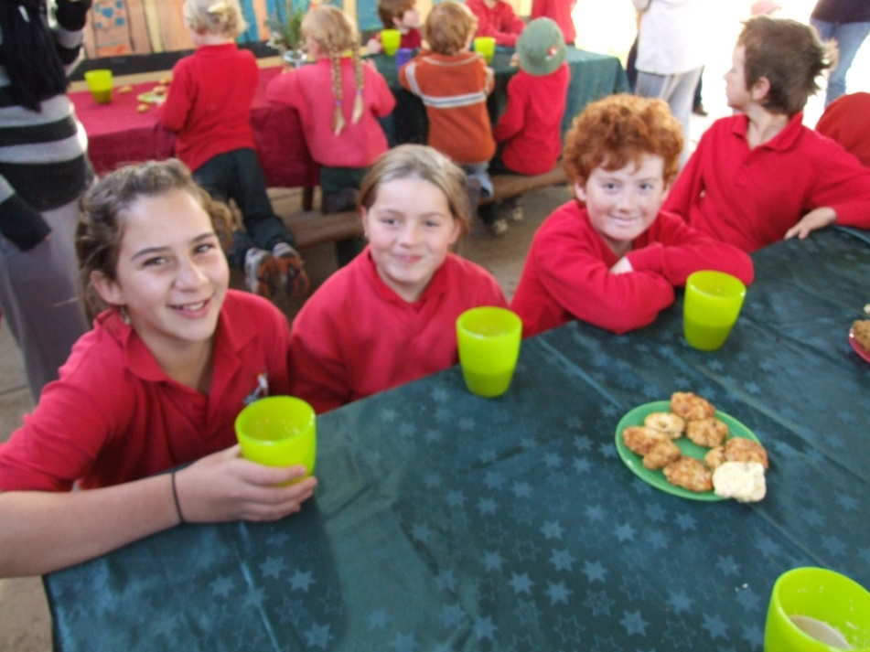
Murringo Public School Stephanie Alexander Kitchen Garden Program

Slide 2
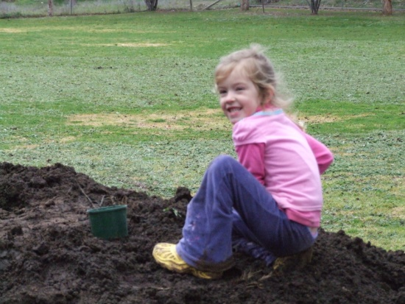
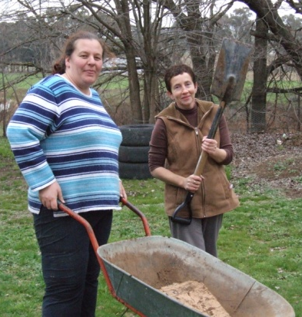
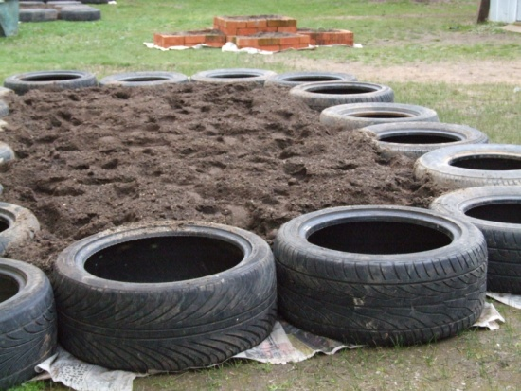
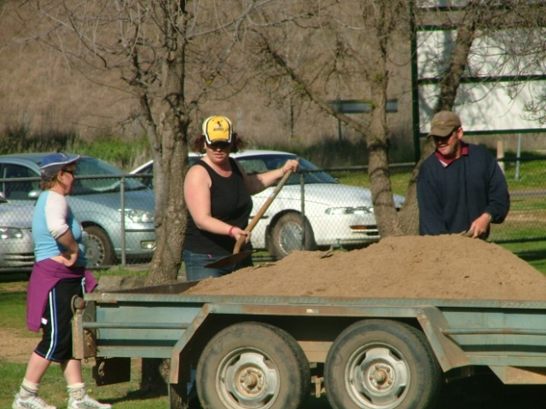
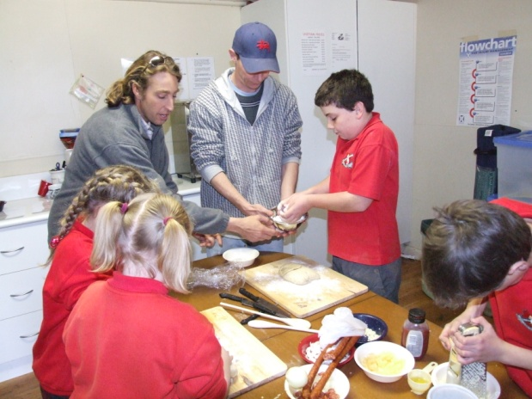
From Small Beginnings ...
In June of 2008 the Murringo P&C Association suggested that the school begin a kitchen garden program after watching a segment on Gardening Australia about the Stephanie Alexander Kitchen Garden Program. The school agreed to the idea and work began straight away. Kitchen and garden lessons began during July of that year.

Slide 3
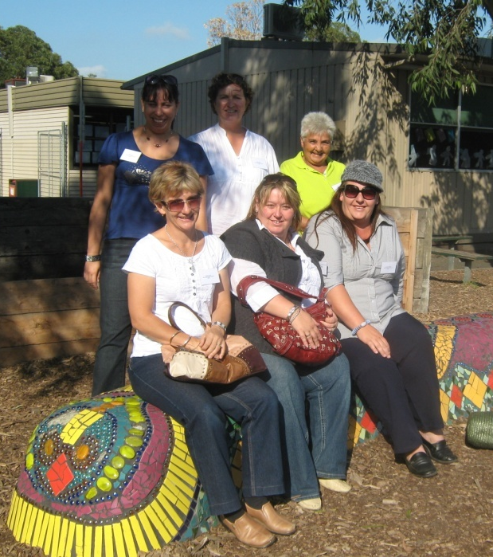
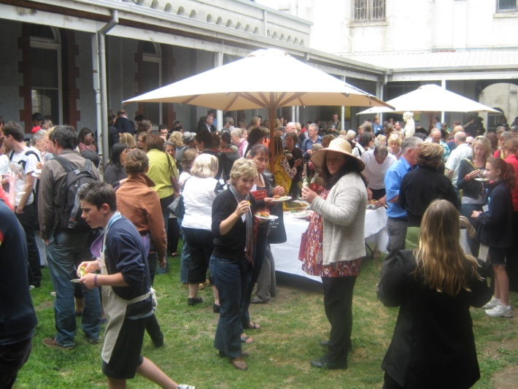
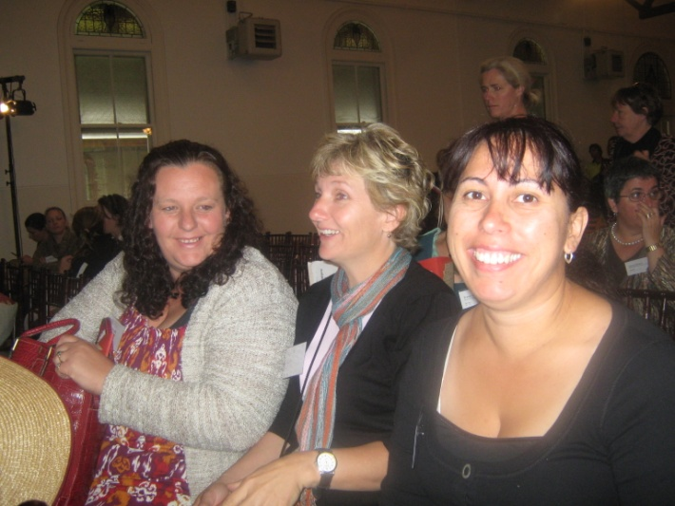
Stephanie Alexander Program
We were aware of the Stephanie Alexander Program but did not realise that it would be made a National Program until late in 2008. We applied for the grant, bought the associated books, regularly checked the website and attended the first Annual Conference. When we were approved as part of the program we also toured a number of schools in Victoria and have enjoyed working with Derek Ashby.

Slide 4
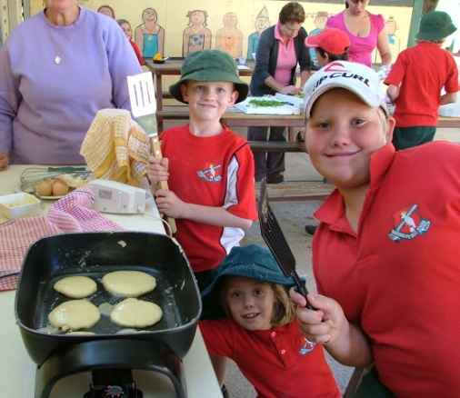
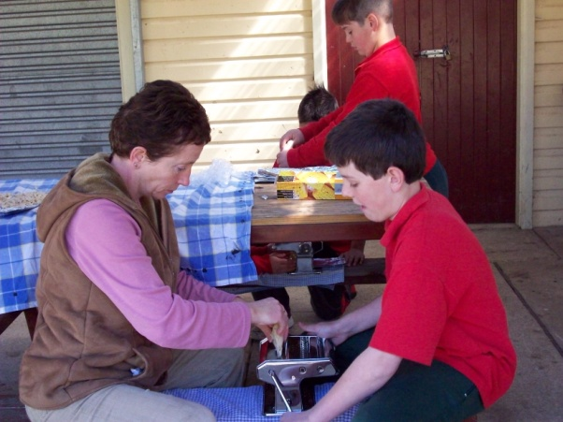
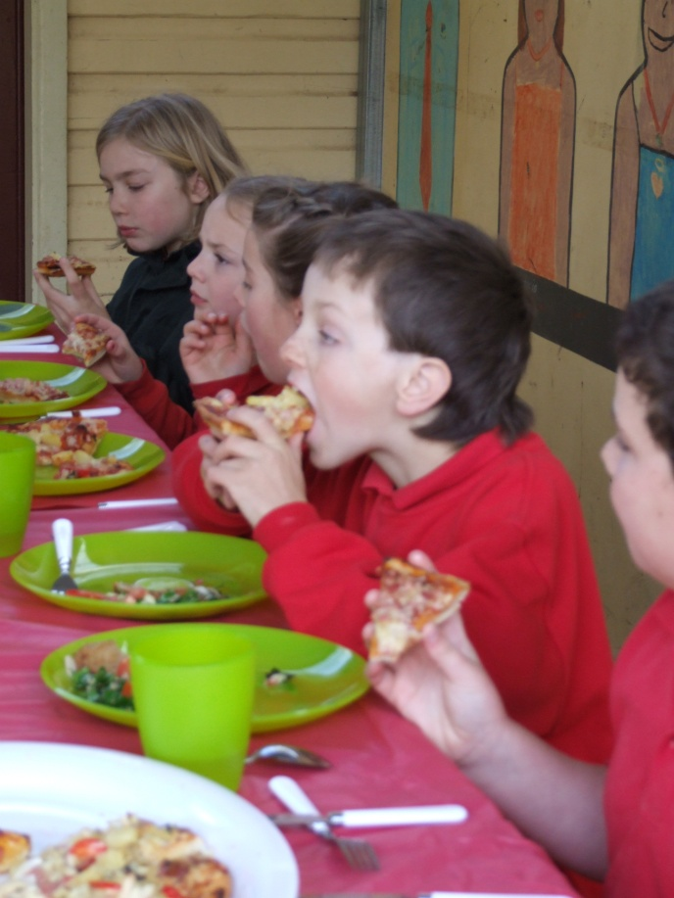
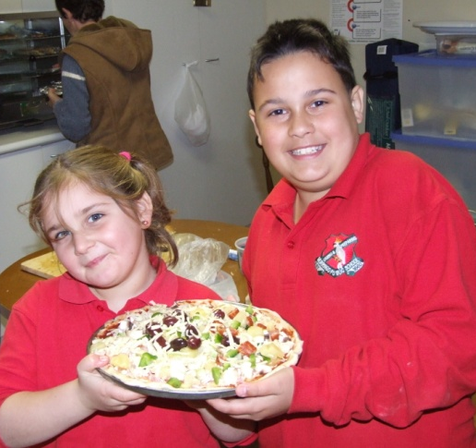
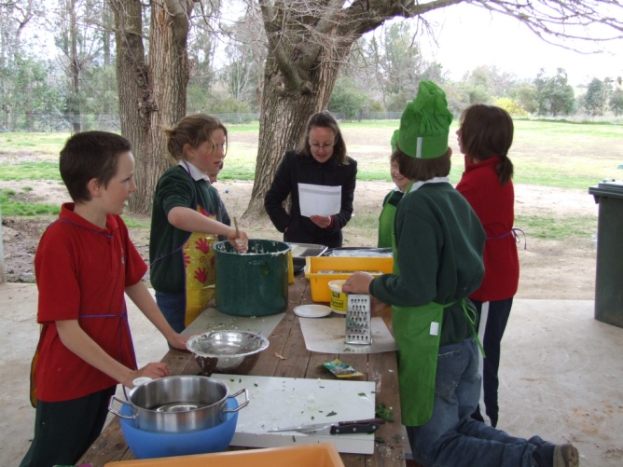
Kitchen Lessons
Our new kitchen is still being built and we have been improvising for over a year now. It will be strange to have an actual kitchen to work in, rather than using the camp stoves, BBQ, electrical appliances and our one small oven! The kids love the kitchen lessons, working with the volunteers and sharing their delicious food.

Slide 5
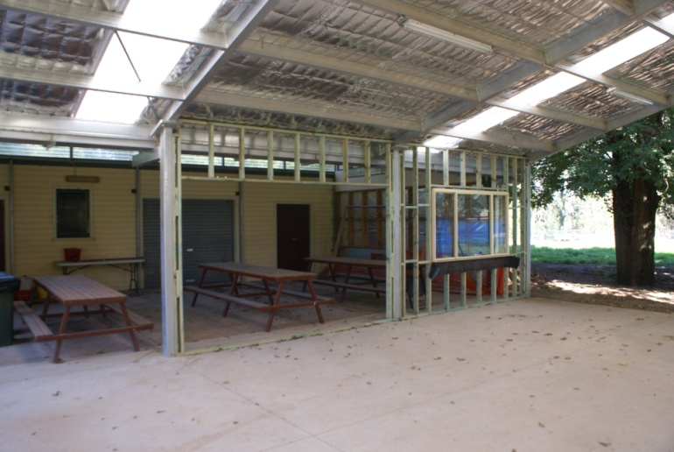
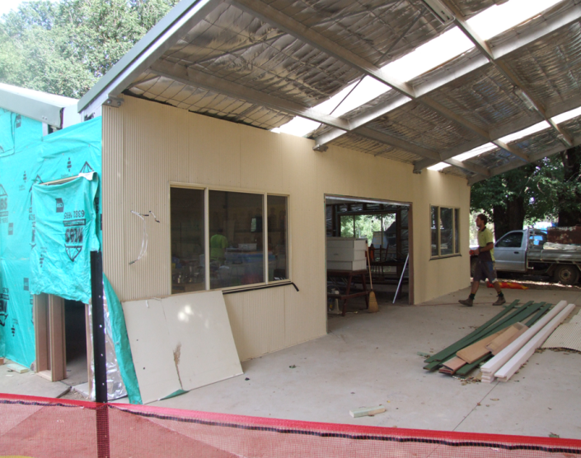
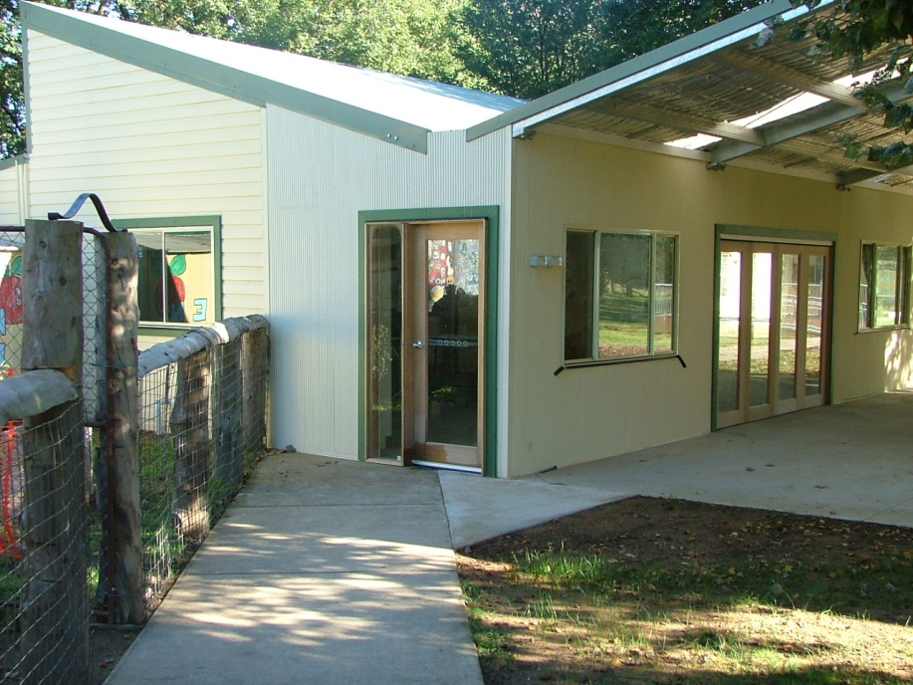
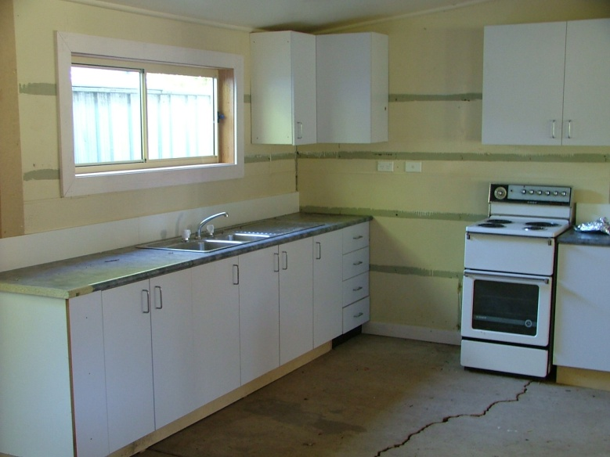
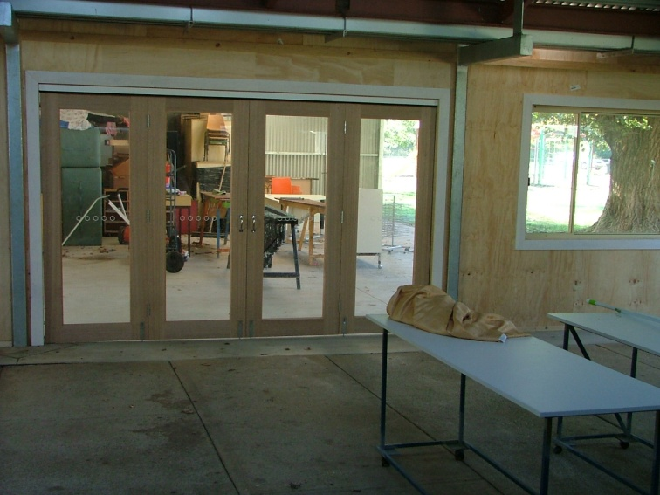
Our New
Kitchen

Slide 6
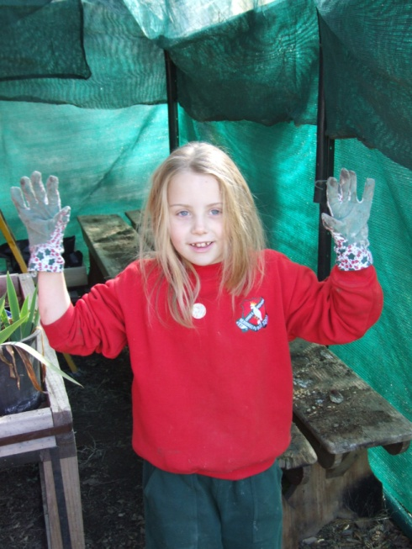
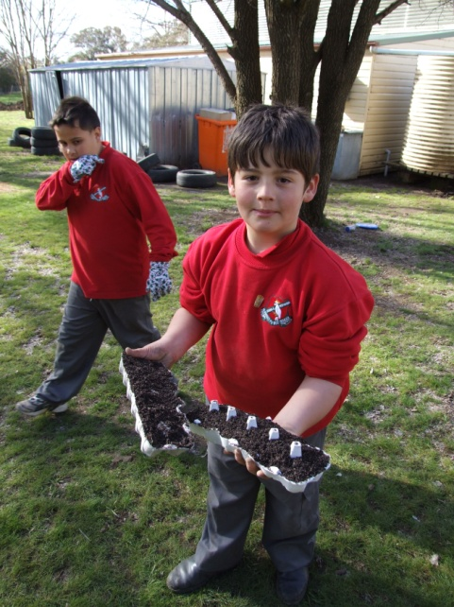
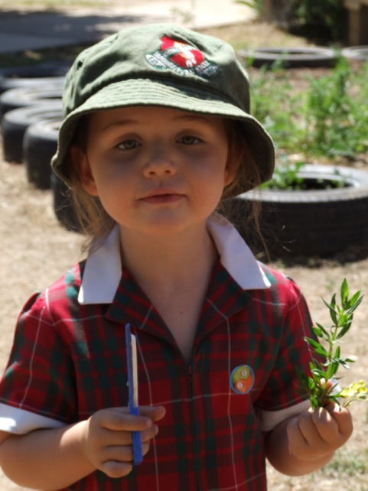
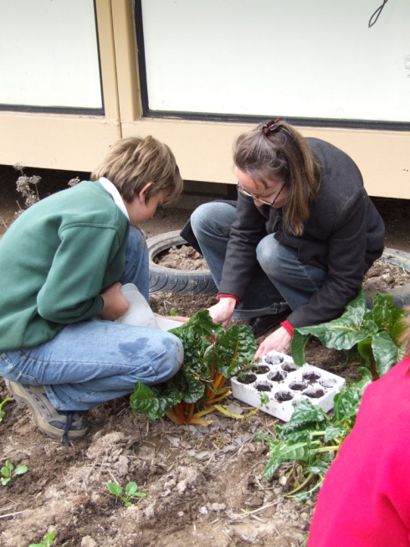
Garden Lessons
Our garden is continually expanding and has changed a lot since we first began. Most of the material that we have built the gardens with has been donated from paddocks and as such has a truly rustic and country feel. The children love to get their hands dirty and are learning from the expertise that our community has to share. Each student has their own garden bed which they care for during lessons and during recess and lunch if they choose.

Slide 7
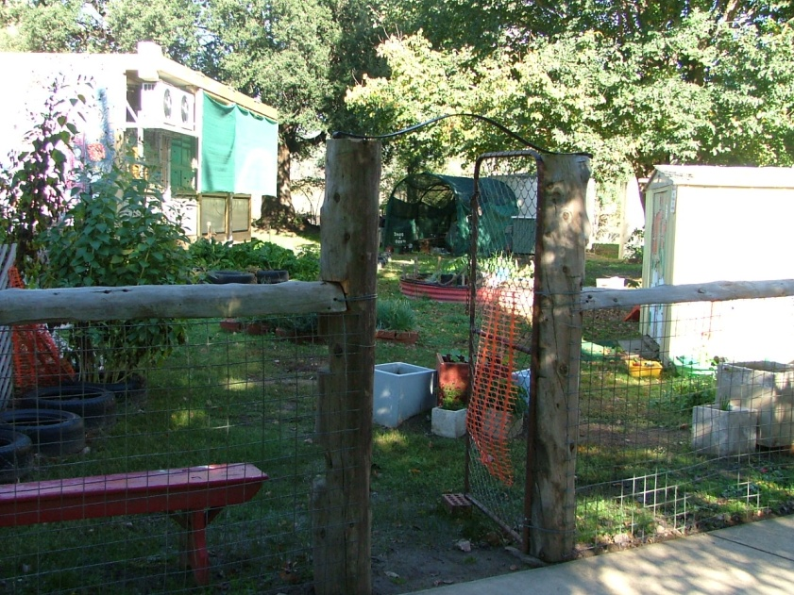
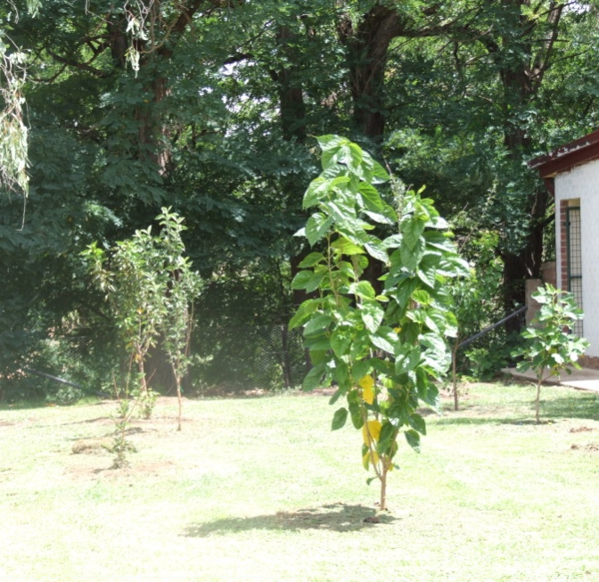
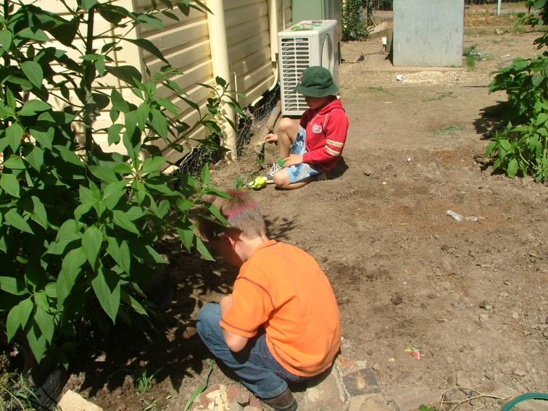
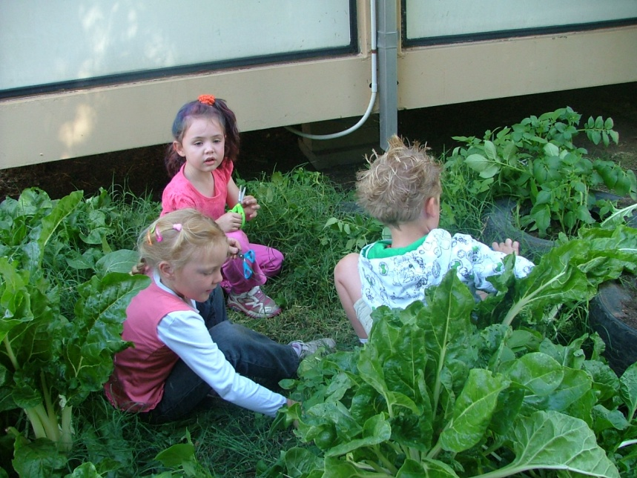
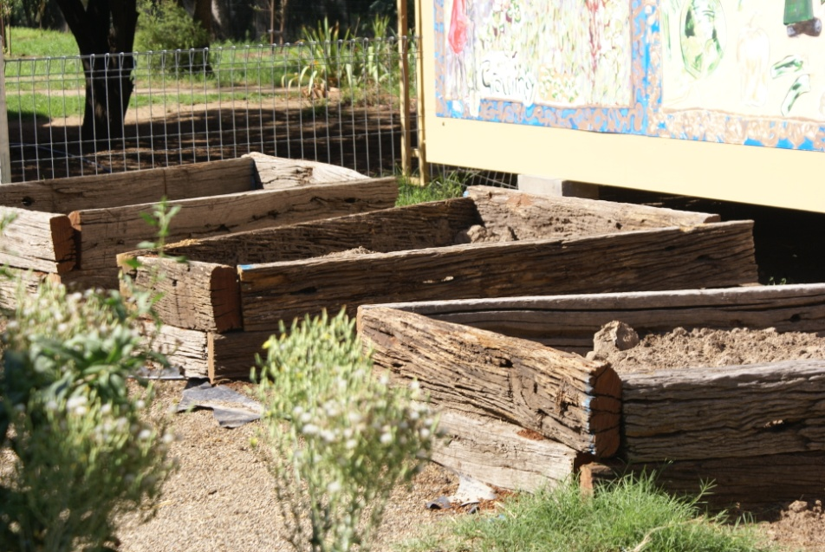
Around Our Garden

Slide 8
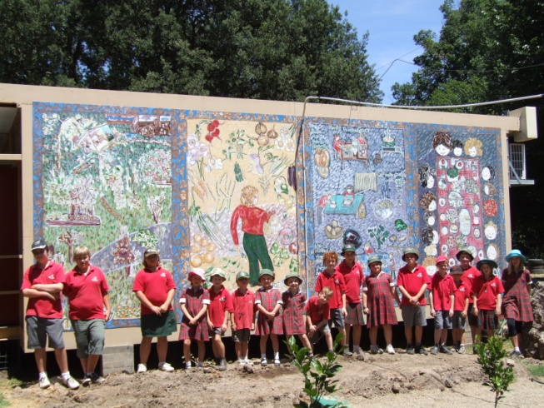
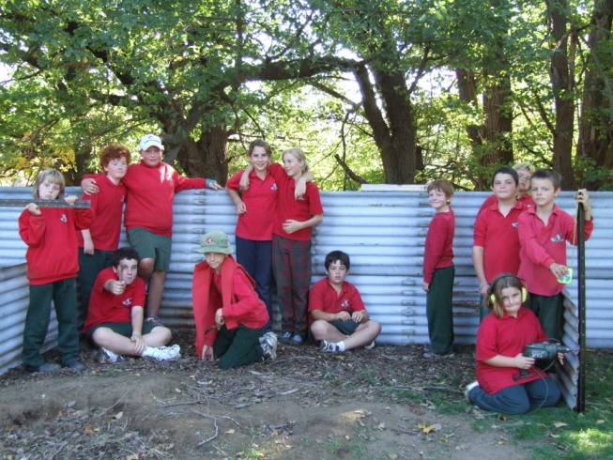
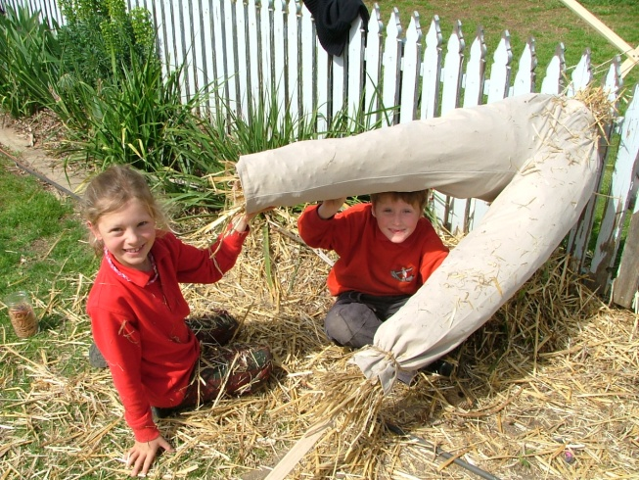
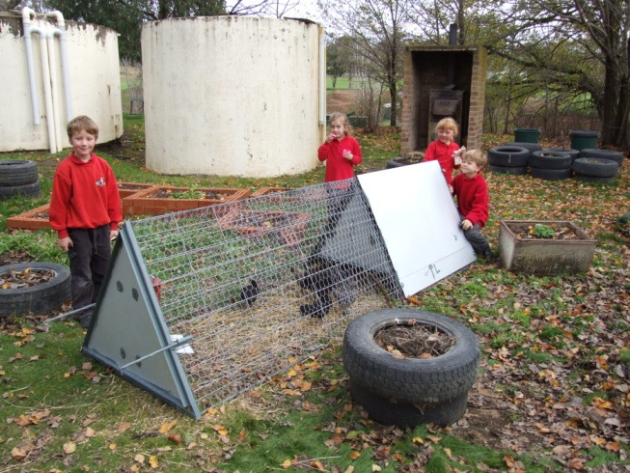
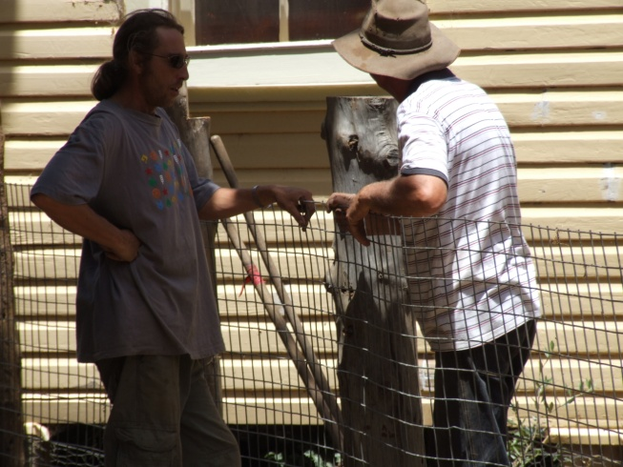
New Additions
Since becoming a member of the National Program, we have expanded the garden, employed a builder to work on our kitchen/dining room, built a portable chookhouse and welcomed our brood, built fences, made scarecrows, established more garden beds, compost bays and murals. We have had a very busy but exciting year.

Slide 9
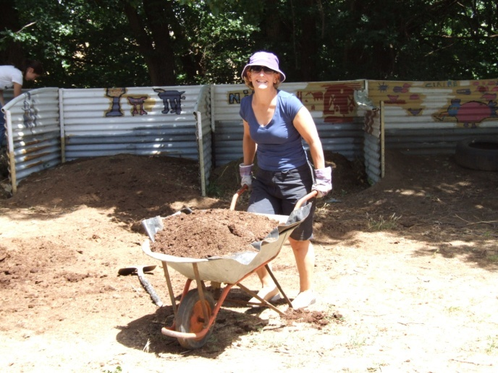
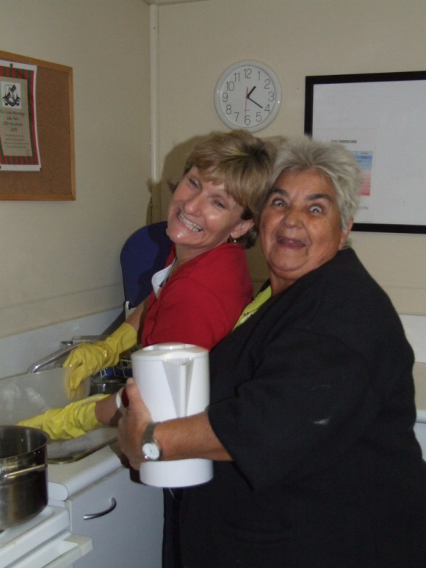
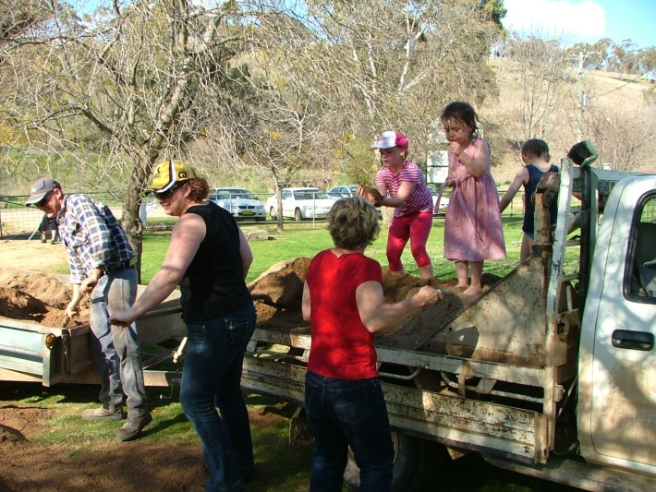
Community Support
Our kitchen garden program has been supported wholeheartedly by our community. They volunteer on Fridays, donate produce and other goods and turn up to working bees. They appreciate what the program is doing for their children and enjoy sharing their wisdom and expertise.

Slide 10
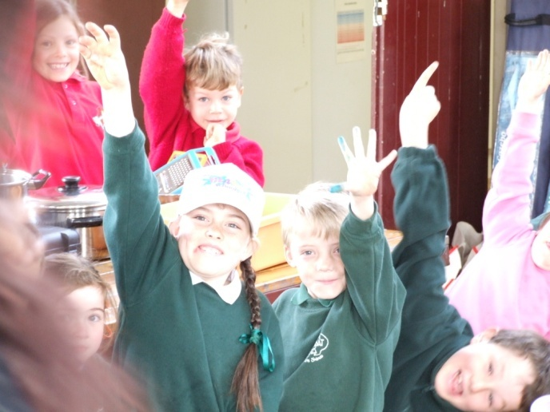
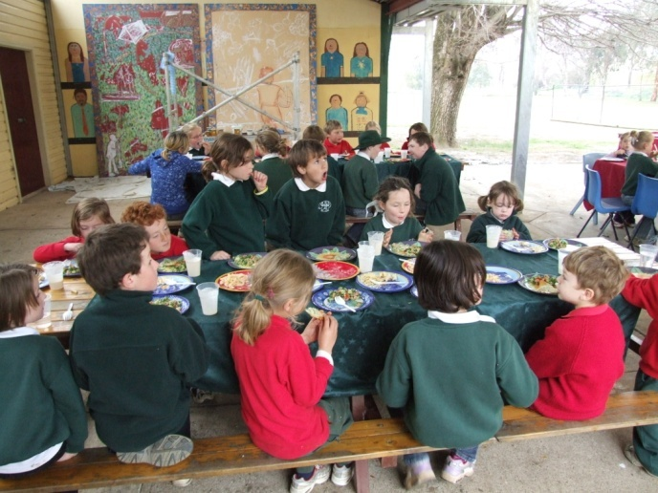
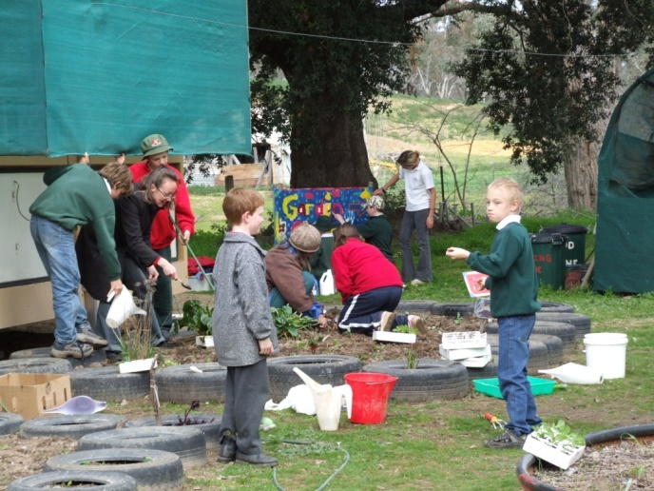
Spreading The Word
This year we have been working with Wombat Public School to help them establish their own kitchen garden program. They came to visit and spent the day cooking and gardening with us. They have since been accepted into Round Two of the National Program and we look forward to continuing to work with them.
In 2010 Murringo Public School is running a Country Areas Program District Initiative to help other schools establish Kitchen Gardens. We will be working closely with Talbingo Public School as they begin their kitchen garden journey.

Slide 11
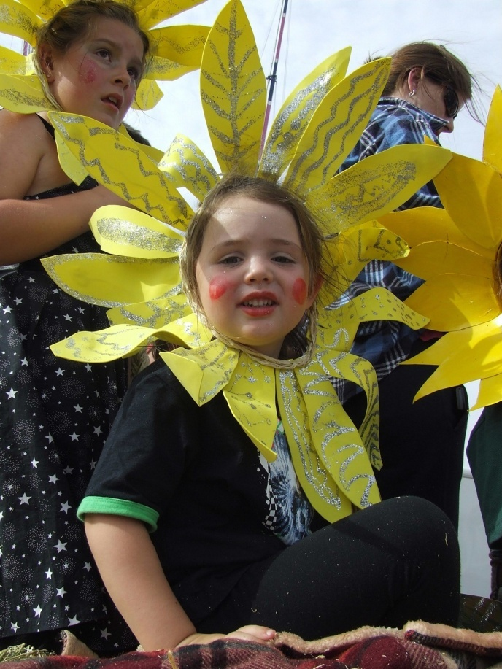
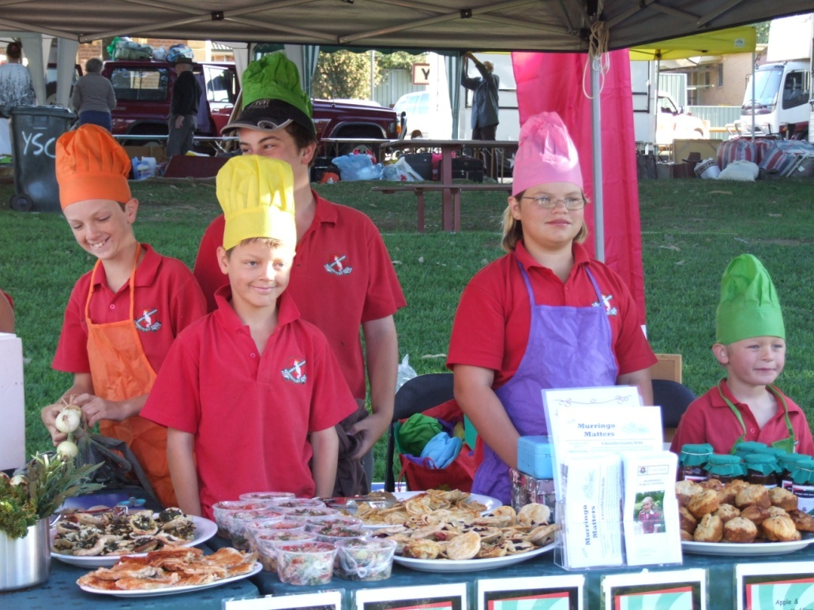
Farmers Markets & Cherry Festival
Our school has developed quite a reputation with regard to this program. We are eagerly awaited at the Farmers Markets, where the kids run a stall full of their own produce, food and preserves. They calculate the money and serve the customers. We also put a float in the National Cherry Festival parade in Young to promote the program. Last year we even met Costa from the SBS Gardening Program.

